Slide 1

TED Event Performance Trends: s An analytical deep dive into TED event success
Team: Emmanuel Fagbenle, Sai Goutham Manukonda, Caleigh Patterson & Abhigna Valambatla
Chosen Dataset:
TED Talks: https://www.kaggle.com/datasets/rounakbanik/ted-talks
Dataset Chosen 11. TED Talks: https://www.kaggle.com/datasets/rounakbanik/ted-talks
Notes:
Title & Introduction

Slide 2


Imagine This:
One TED Talk, delivered on a small stage, sparks a global movement, and inspires millions.
fill But not all ideas spread equally.
fill
Today, we’ll uncover how data can shed light on the key factors that drive TED event success and make an idea worth spreading truly unstoppable.
2
Notes:
Caleigh
Hook / Opening Statement

Slide 3
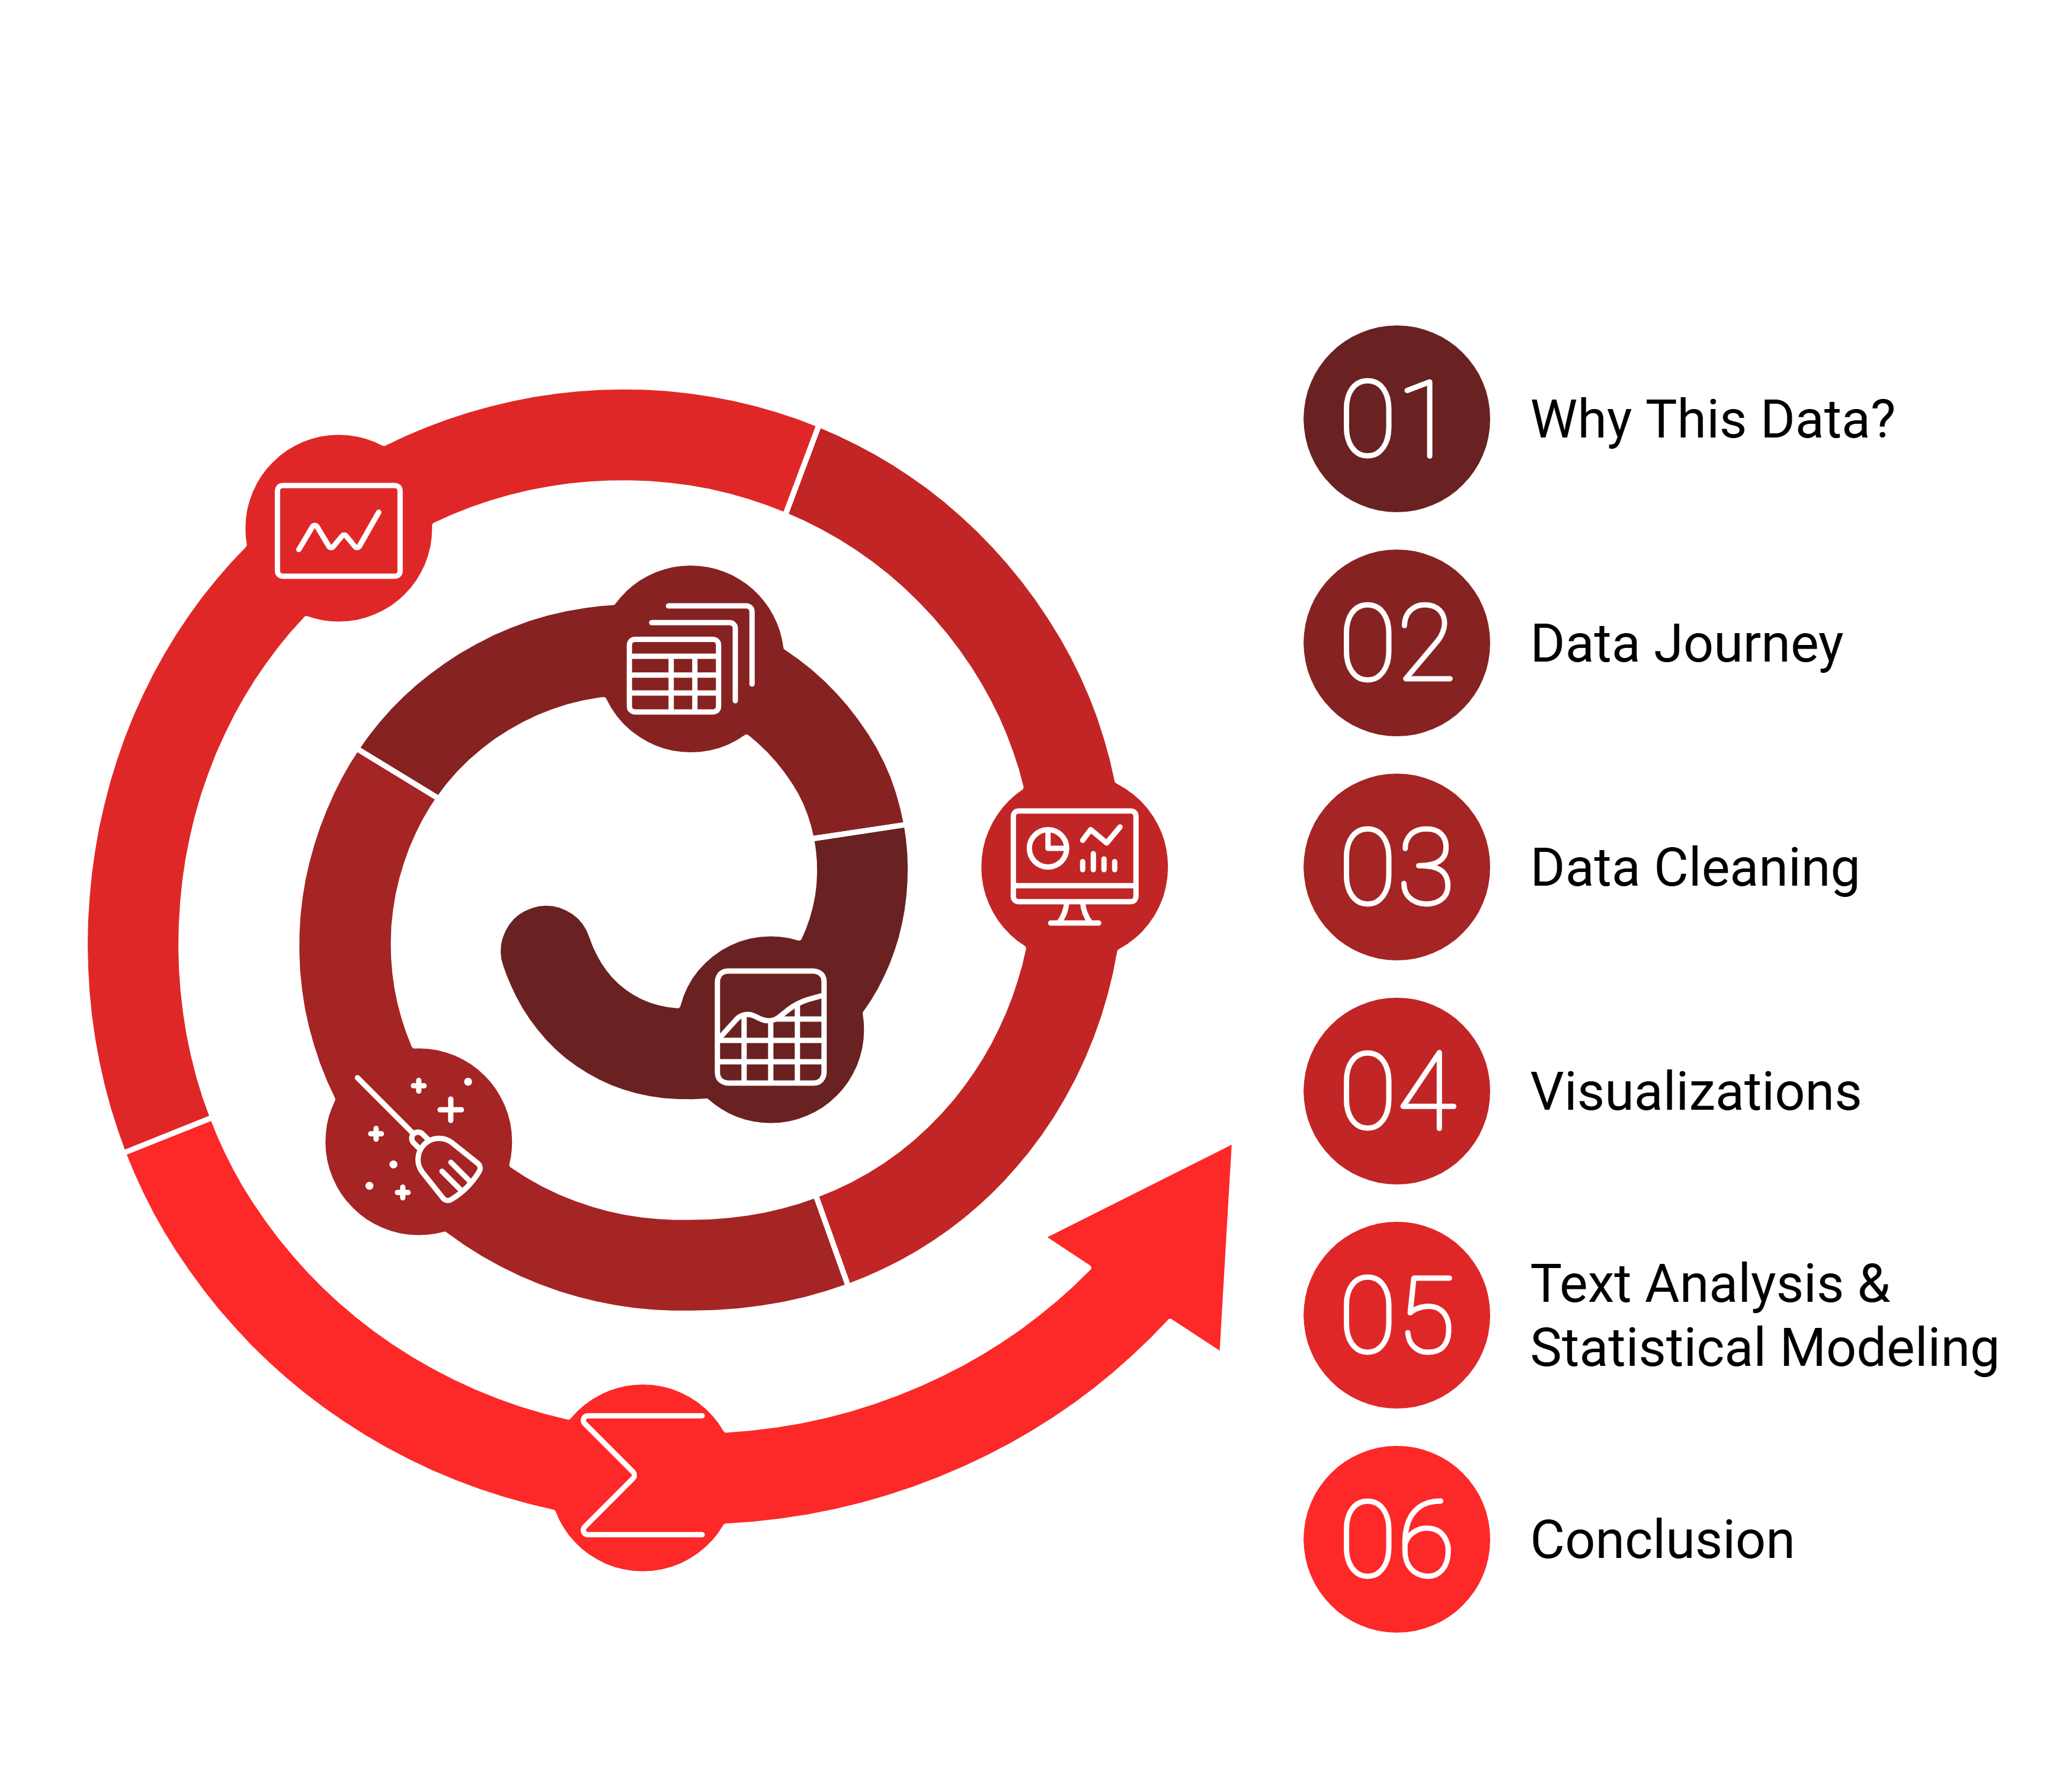

Agenda:
3
Notes:
Caleigh
Agenda!

Slide 4
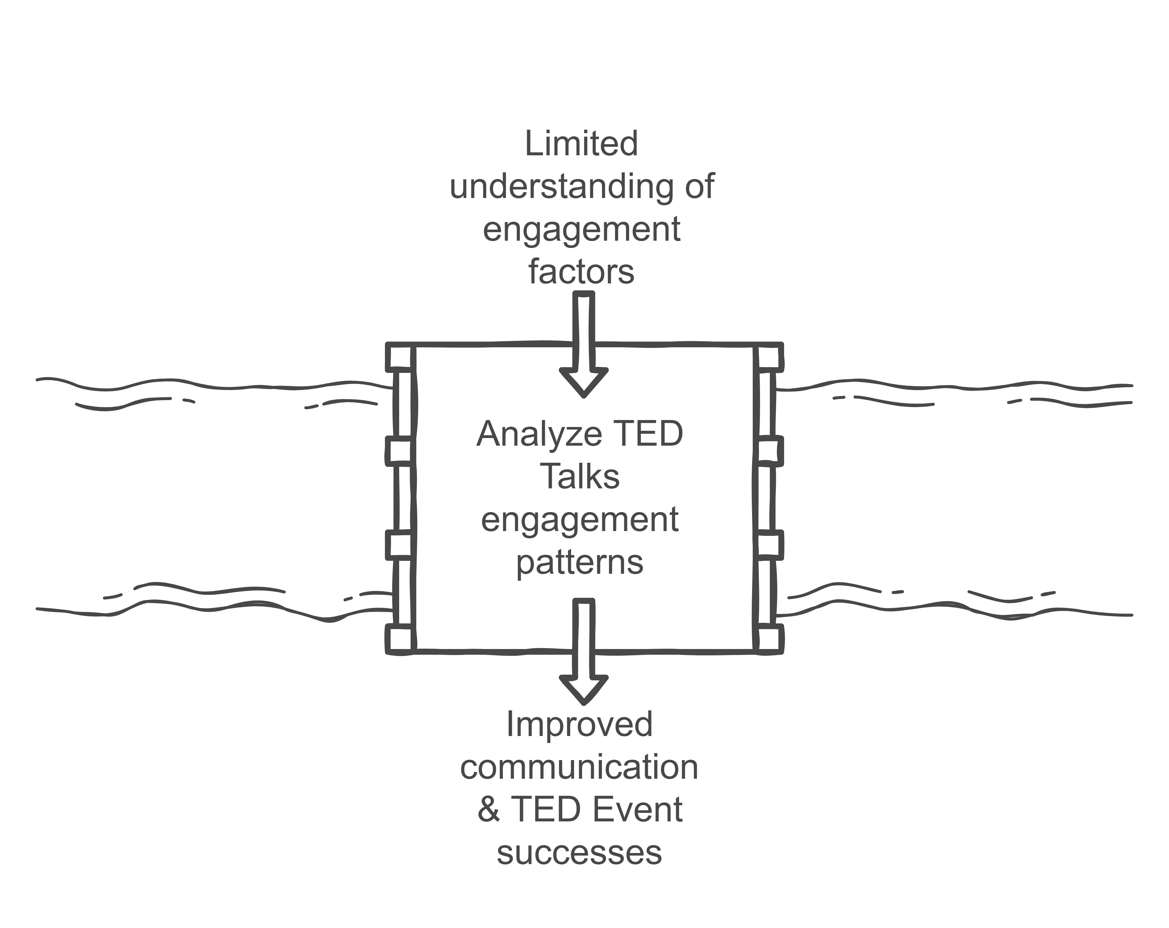
Why this data?
Insights:
What topics resonate most with audiences?
How do view counts correlate with engagement metrics?
4
Notes:
Caleigh
"Why this dataset?
Image:
We want to be the bridge in the gap between understanding TED Talks engagement factors and use those insights to improve communication strategies and the future success of TED Events.
The dataset's diversity, inclusing speaker occupation, topics, and themes allow deep insights into patterns and trends.
Analyzing this data will help uncover what drives engagement and impact, supporting the mission of meaningful change."
Some insights I initally thought of finding out from this dataset were:
What topics resonate most?
How do view counts correlate

Slide 5
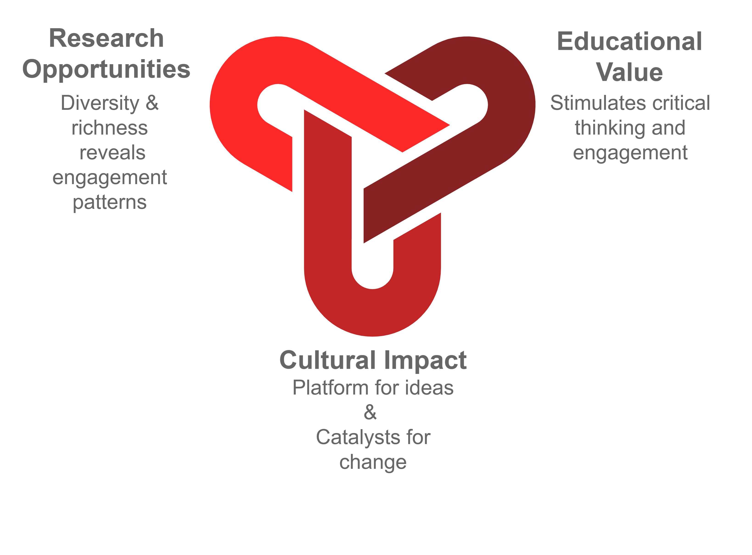
TED Talks Significance & Impacts
5
Notes:
Caleigh
Impact:
TED Talks influence millions globally
TED Talks = platform for ideas & catalysts for change
Research Opportunities:
Measurable attributes such as views and comments provide quantifiable insights into engagement patterns
Educational Value:
TED Talks are an important insight into public discussions today & can help drive someone's passion about a topic
They can stimulate critical thinking & Drive the audience to take action.

Slide 6
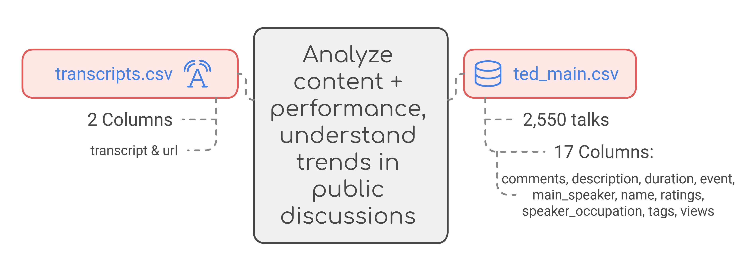
TED Talks Metadata:
All Ted Talks uploaded to TED.com through Sept. 21, 2017.
6
Notes:
Goutham
Data we used contained 2 csv's:
Transcripts.csv
Ted_main.csv
We will explore, clean, and use this data to analyze content and performance,
Then understand the trends in public discussions and see what engages people more.

Slide 7
Data Journey
Raw Data:
Contained no duplicates but had some missing information
Columns were added, deleted, organized & structured
Required preprocessing to extract meaningful insights.
Clean Data:
Organized and standardized for analysis
No duplicates & missing values addressed, anomalies corrected
Optimized for visualization and decision-making
7
Notes:
Goutham
Raw data:
No duplicates of blank rows
Minimal missing data
Anomalies
Clean data:
NA/null values were addressed
The datasets were merged and cleaned to reorder and add columns to allow for easier further analyses
Optimized dataset for visualization and decision-making

Slide 8
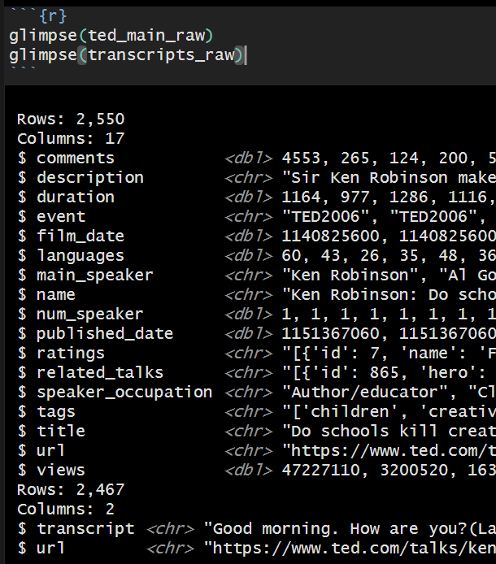
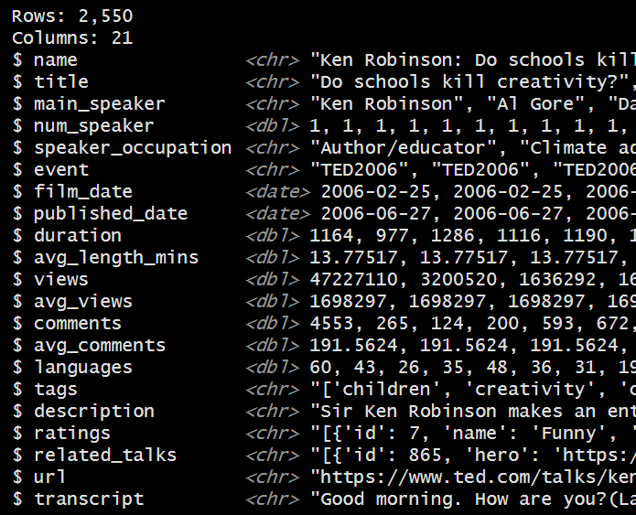

















Raw vs Clean Data
Notes:
Goutham
Ted_main had 2,550 rows and 17 columns
Transcripts had 2,467 rows and 2 columns
Cleaned Ted Dataframe:
2,550 rows
21 columns
Added
Avg_comments
Avg_views
Avg_length_mins
Transcripts added through merge (on url columns)

Slide 9


Data Cleaning
0
1
2550
21
ted_main
2
Joined
on the
URL
column
Duplicates Rows
Column with missing Values
Rows
Columns
Data Sets
transcript
0
0
2471
2
Data was cleaned in R
Extra Columns (Average comments, Average views & Average duration in minutes) were added to the cleaned dataset.
9
Notes:
Emmanuel1
Better visual explaining our data cleaning process

Slide 10
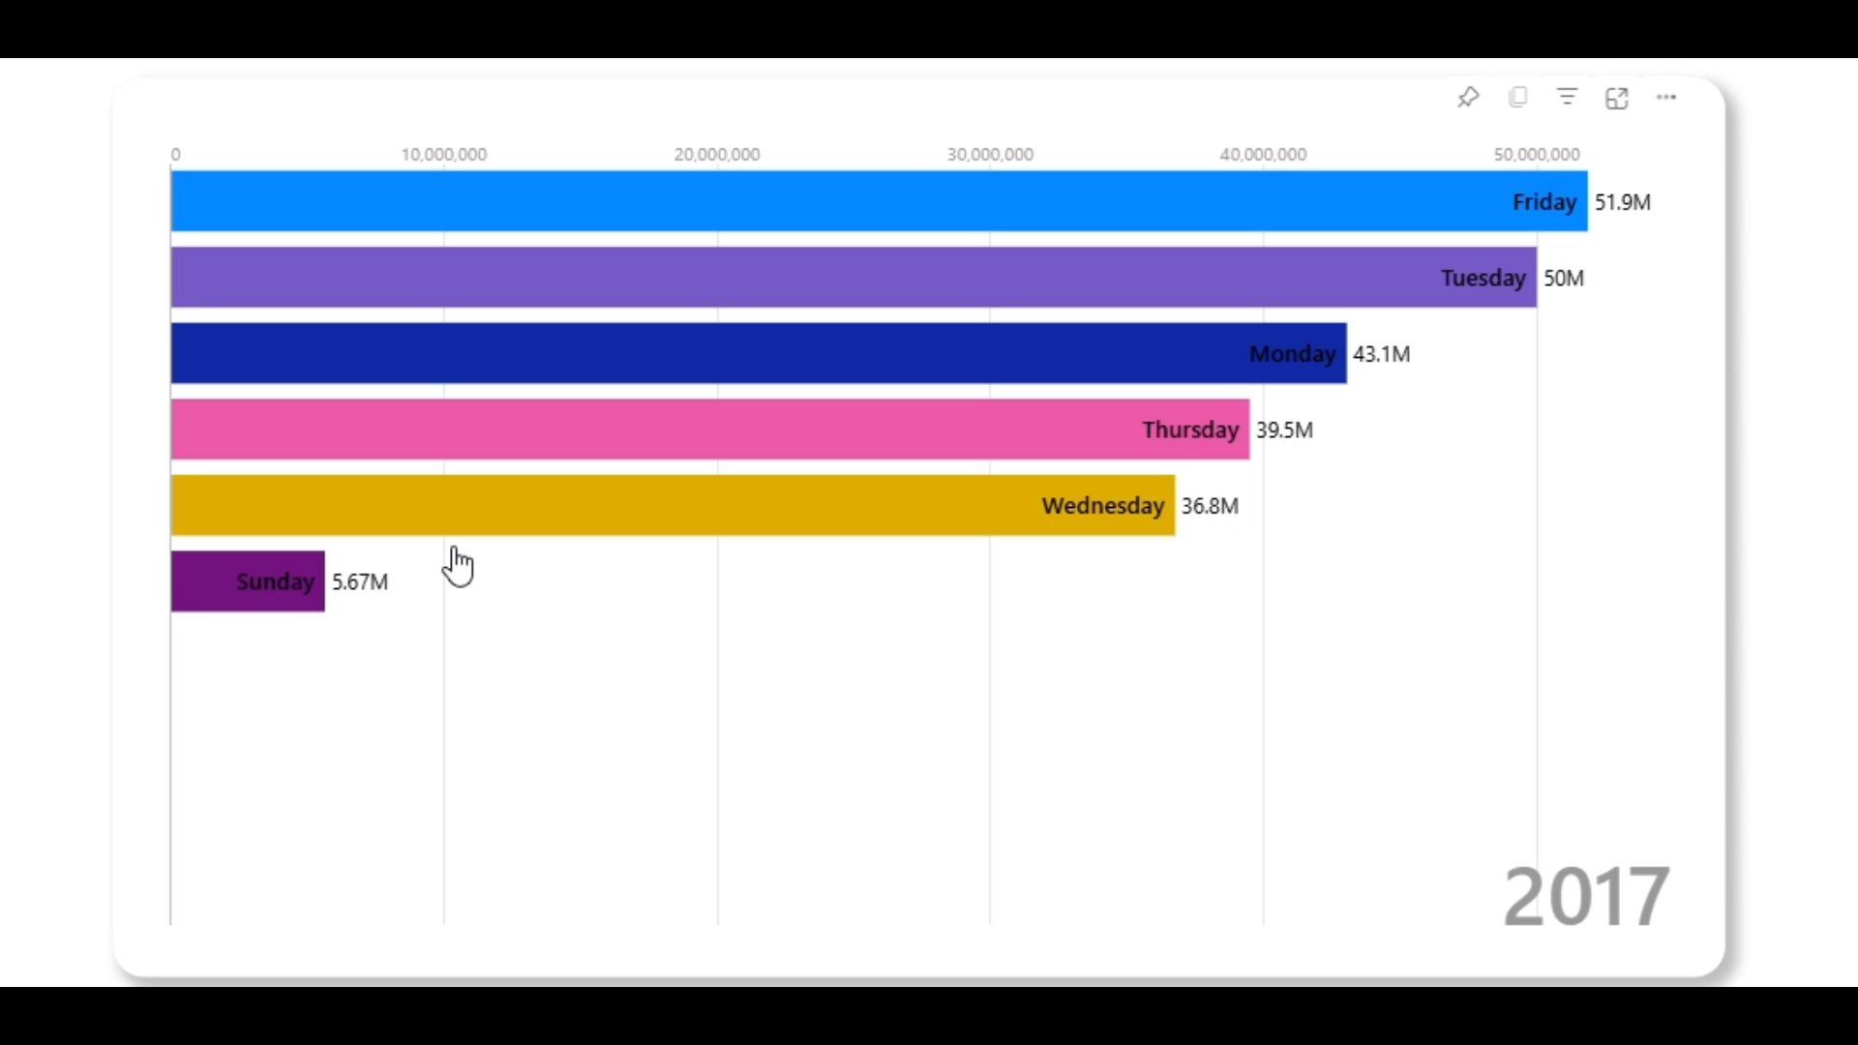
Weekday with most TED views '10 - '17
10
Notes:
Emmanuel2 - EDA
Finding: the most consistent day of the week associated used to consistently be Monday, then in 2013, Friday was consistently the highest association, with Tuesday close behind in second during 2017

Slide 11
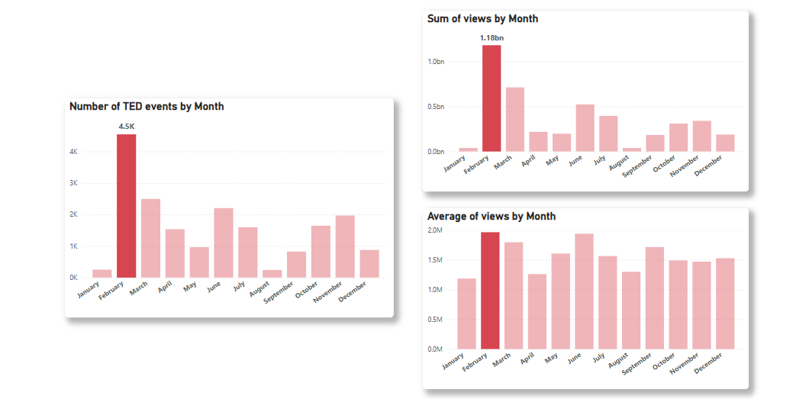
Best month to Publish a TED X Event
11
Notes:
Emmanuel3 - EDA

Slide 12
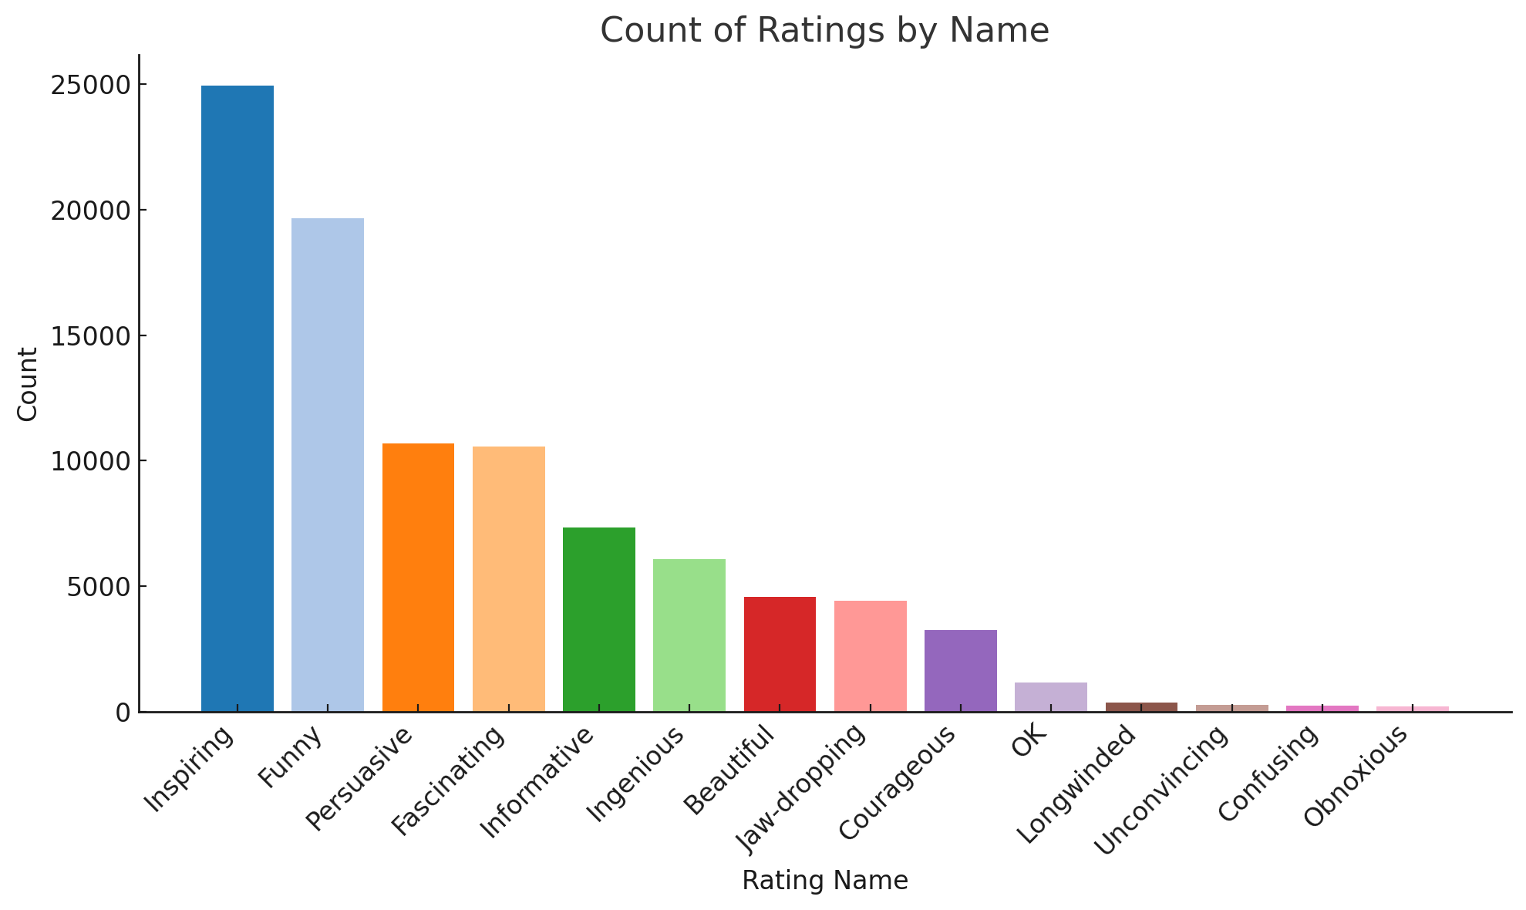
How TED Talks Resonate with Audiences: Ratings Breakdown
Key Insights
fill
"Inspiring" and "Funny" are the most common ratings, indicating that audiences connect deeply with talks that motivate or entertain.
fill
Inspiration, humor, and impact are key drivers of TED Talk success.
12
Notes:
Abhi1

Slide 13
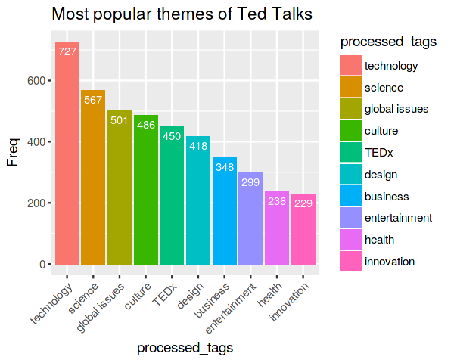
Most Popular Themes in TED Talks
Key Insights
fill
TED Talks cover a broad spectrum of themes, but technology, science, and global issues remain at the core of audience engagement.
13
Notes:
Abhi2

Slide 14
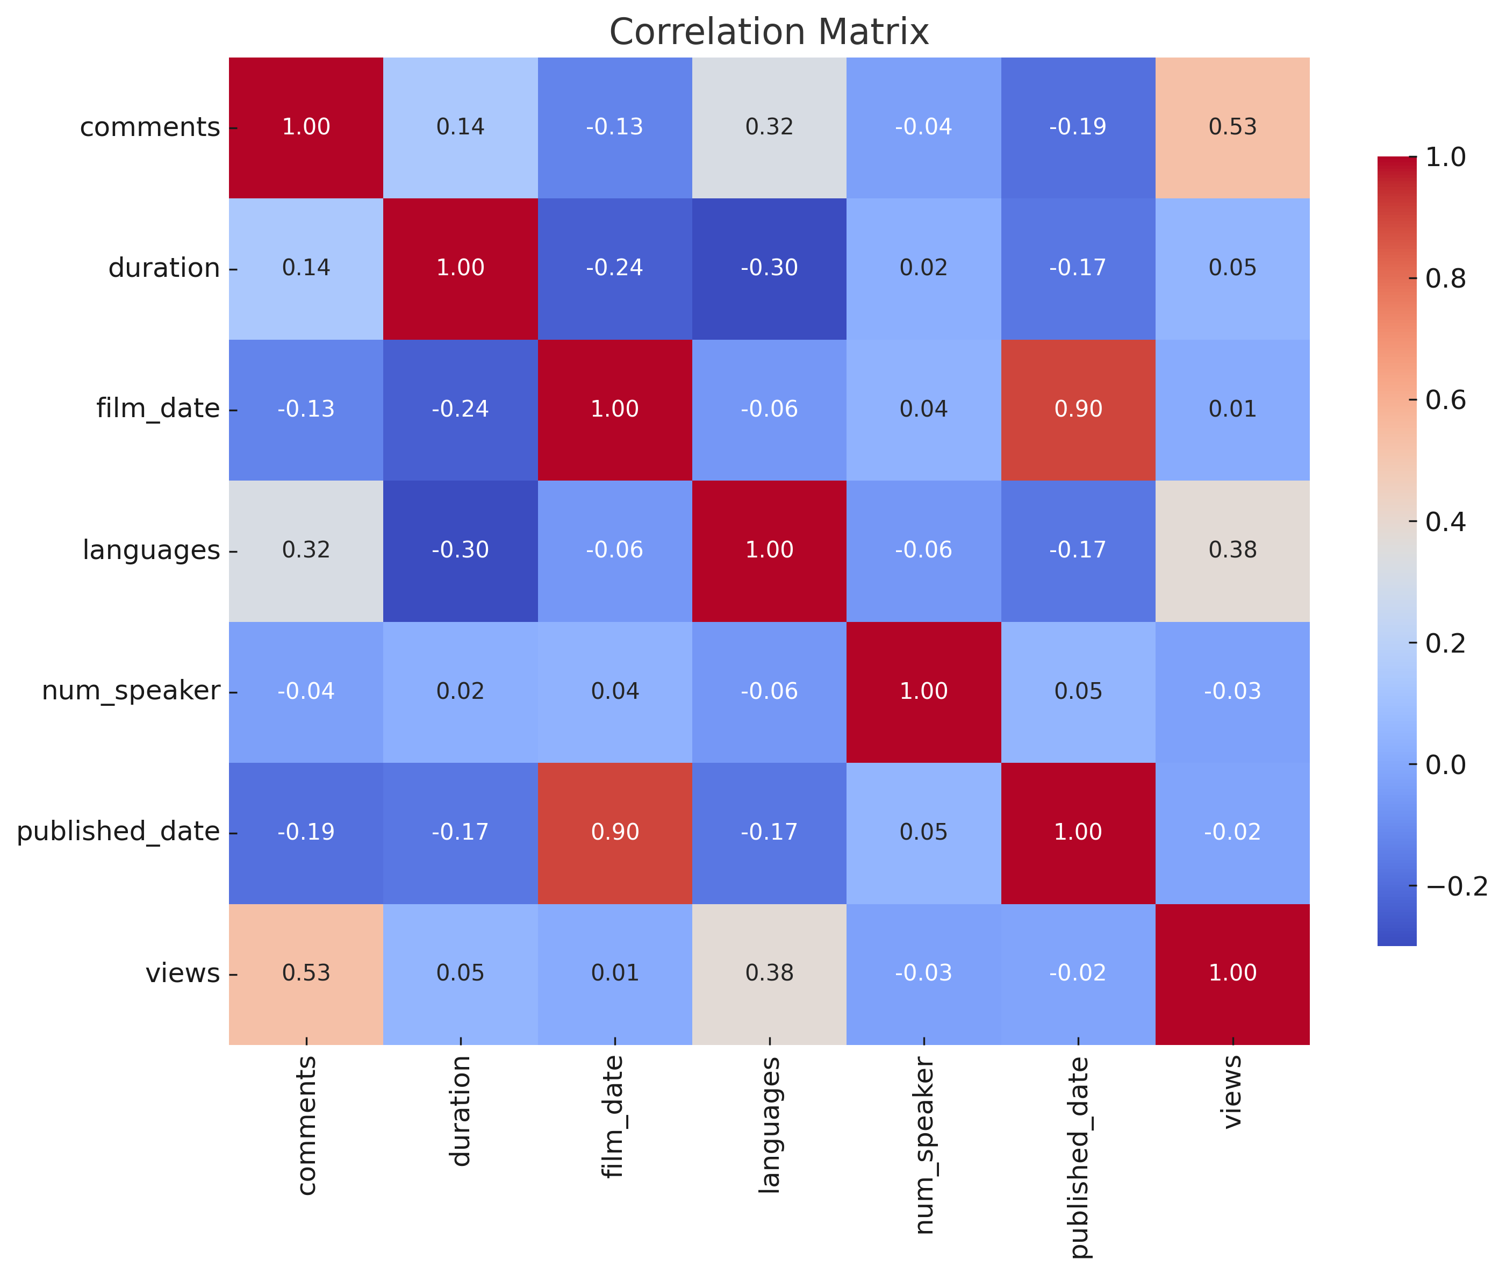
Correlation Between TED Talk Features
Key Insights
fill
Strong Positive Correlations: Film Date and Published Date (0.9) Views and Comments (0.53)
fill
Moderate Correlation: Languages and Views (0.38)
fill
Weak or Negative Correlations: Duration has minimal impact on Views (0.05).
fill
Audience engagement (comments) and views are the strongest indicators of a talk's impact.
14
Notes:
Abhi3

Slide 15
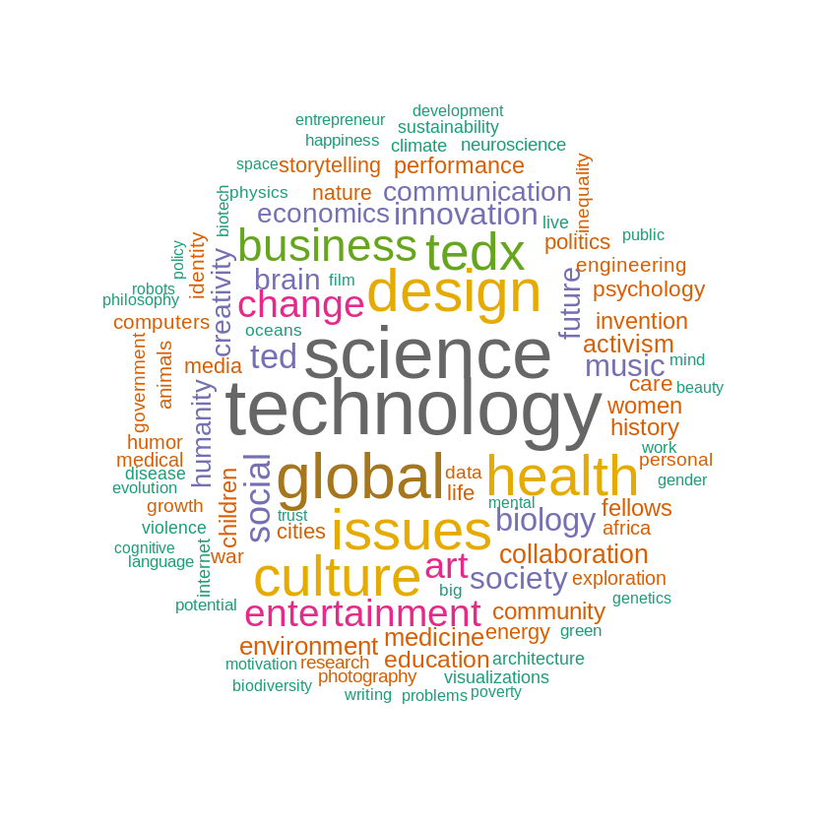
Text Analysis - Word Cloud TED Talk Transcript
What It Tells Us
fill
Larger words = higher frequency in TED Talk transcripts.
fill
Smaller words represent less frequent but important topics like art, humor, Poverty.
15
Notes:
Abhi4
Narrate what the text analysis revealed, using specific examples or cases to illustrate key points.
analyzing the content of the TED Talks to extract meaningful insights related to language use, topic relevance, sentiment, or themes.
Slide 2: Key Findings from Text Analysis
Present specific findings (e.g., most common words, topics, or phrases).
Use visuals such as word clouds or bar charts to show prevalence of certain themes.

Slide 16

Text Analysis - Word Cloud
Occupation
What It Tells Us
fill
Prominent occupations include Writer, Architect, Entrepreneur, Artist, and Journalist.
fill
Smaller roles like Data Scientist, Marine Biologist, and Activist highlight specialized expertise.
fill
TED features multi-disciplinary experts, combining creativity, science, and innovation to inspire global audiences.
16
Notes:
Abhi5
Narrate what the text analysis revealed, using specific examples or cases to illustrate key points.
analyzing the content of the TED Talks to extract meaningful insights related to language use, topic relevance, sentiment, or themes.
Slide 2: Key Findings from Text Analysis
Present specific findings (e.g., most common words, topics, or phrases).
Use visuals such as word clouds or bar charts to show prevalence of certain themes.

Slide 17
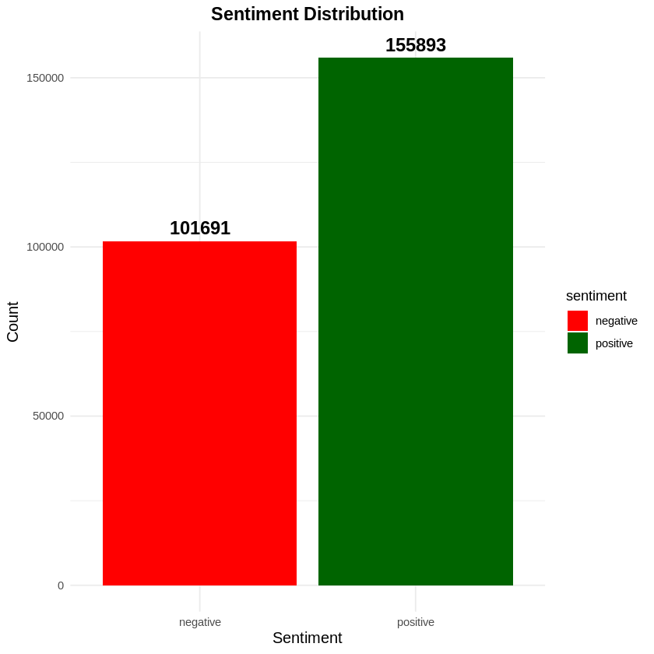
Sentiment Analysis
What It Tells Us
fill
Positive sentiments (155,893) are significantly higher than negative ones (101,691), showing overall positive feedback.​
fill
​ The difference of 54,202 highlights a strong lean toward positivity.​
fill
While positivity dominates, 40% of sentiments are negative, indicating areas for improvement.
17
Notes:
Abhi6
Narrate what the text analysis revealed, using specific examples or cases to illustrate key points.
analyzing the content of the TED Talks to extract meaningful insights related to language use, topic relevance, sentiment, or themes.
Slide 3: Case Studies and Examples
Highlight notable examples of TED Talks that illustrate your findings (e.g., a talk with a high sentiment score that became very popular).
Discuss how the language or themes contributed to its success.

Slide 18
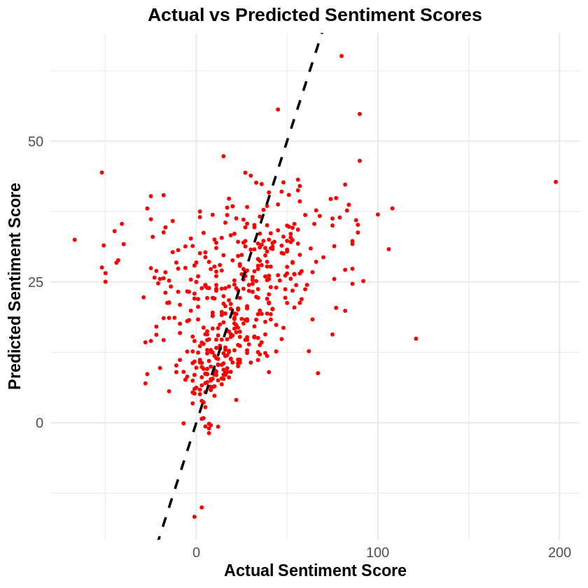
Statistical Modeling- Linear Regression
What It Tells Us
fill
Noticeable upward trend, indicating a Positive correlation between actual and predicted sentiment scores.
Outliers deviate significantly from the trend, suggesting areas where the model's predictions were less accurate.
18
Notes:
Abhi
Explain the choice of models as part of the investigative process and share the insights they uncovered.
explaining the statistical models chosen, their purpose, and the insights gained from them.
Modeling Approach
Introduce the statistical models you utilized (e.g., regression analysis, classification algorithms, or clustering methods).
Explain why you chose those models and how they relate to your research questions.
Model Outcomes and Insights
Share the results obtained from the models (e.g., which factors were significant predictors of views or engagement).
Use visuals such as confusion matrices or regression plots to clarify results.

Slide 19
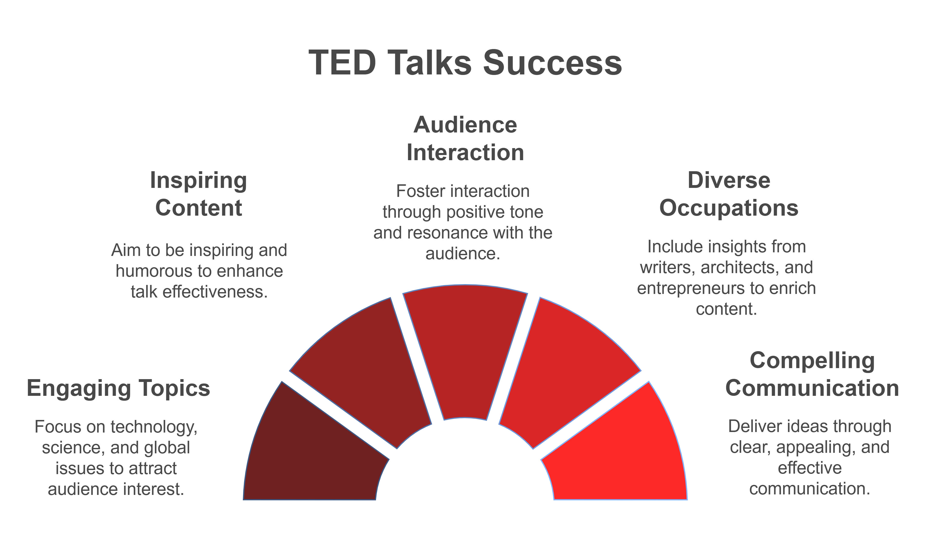

Conclusion:
19
Notes:
Caleigh
Conclude with the main 'moral' of your story - the key insights and their implications.

Slide 20

Thank You! Questions?
"Without data, you're just another person with an opinion."
~ W. Edwards Deming
20
Notes:
Caleigh

